Slide 1

Spreadsheet Modeling
& Decision Analysis
A Practical Introduction to Business Analytics
8th edition
Cliff T. Ragsdale

Slide 2
Sensitivity Analysis and the Simplex Method
Chapter 4

Slide 3
Introduction
When solving an LP problem we assume that values of all model coefficients are known with certainty.
Such certainty rarely exists.
Sensitivity analysis helps answer questions about how sensitive the optimal solution is to changes in various coefficients in a model.

Slide 4
General Form of a
Linear Programming (LP) Problem
MAX (or MIN): c₁X₁ + c₂X₂ + … + c_{n}X_{n}
Subject to: a₁₁X₁ + a₁₂X₂ + … + a_{1n}X_{n} <= b₁
:
a_{k1}X₁ + a_{k2}X₂ + … + a_{kn}X_{n} >= b_{k}
:
a_{m1}X₁ + a_{m2}X₂ + … + a_{mn}X_{n} = b_{m}
How sensitive is a solution to changes in the c_{i}, a_{ij}, and b_{i}?

Slide 5
Approaches to Sensitivity Analysis
Change the data and re-solve the model!
  Sometimes this is the only practical approach.
Solver also produces sensitivity reports that can answer various questions…

Slide 6
Solver’s Sensitivity Report
Answers questions about:
  Amounts by which objective function coefficients can change without changing the optimal solution.
  The impact on the optimal objective function value of changes in constrained resources.
  The impact on the optimal objective function value of forced changes in decision variables.
  The impact changes in constraint coefficients will have on the optimal solution.

Slide 7
Software Note
When solving LP problems, be sure to use an LP algorithm/engine as this allows Solver to provide more sensitivity information than it could otherwise.

Slide 8
Once Again, We’ll Use The
Blue Ridge Hot Tubs Example...
MAX: 350X₁ + 300X₂ } profit
S.T.: 1X₁ + 1X₂ <= 200 } pumps
9X₁ + 6X₂ <= 1566 } labor
12X₁ + 16X₂ <= 2880 } tubing
X₁, X₂ >= 0 } nonnegativity

Slide 9
The Answer Report
See file Fig4-1.xlsm

Slide 10
The Sensitivity Report
See file Fig4-1.xlsm

Slide 11
How Changes in Objective Coefficients Change the Slope of the Level Curve
X₂
250
original level curve
200
new optimal solution
150
original optimal solution
100
new level curve
50
0
0
50
100
150
200
250
X₁

Slide 12
How Changes in Objective Coefficients Change the Slope of the Level Curve
See file Fig4-4.xlsm

Slide 13
Changes in
Objective Function Coefficients
Values in the “Allowable Increase” and “Allowable Decrease” columns for the Decision Cells indicate the amounts by which an objective function coefficient can change without changing the optimal solution, assuming all other coefficients remain constant.

Slide 14
Alternate Optimal Solutions
Values of zero (0) in the “Allowable Increase” or “Allowable Decrease” columns for the Decision Cells indicate that an alternate optimal solution exists.

Slide 15
Changes in Constraint RHS Values
The shadow price of a constraint indicates the amount by which the objective function value changes given a unit increase in the RHS value of the constraint, assuming all other coefficients remain constant.
Shadow prices hold only within RHS changes falling within the values in “Allowable Increase” and “Allowable Decrease” columns.
Shadow prices for nonbinding constraints are always zero.

Slide 16
Comments About Changes in Constraint RHS Values
Shadow prices only indicate the changes that occur in the objective function value as RHS values change.
Changing a RHS value for a binding constraint also changes the feasible region and the optimal solution (see graph on following slide).
To find the optimal solution after changing a binding RHS value, you must re-solve the problem.

Slide 17
How Changing an RHS Value Can Change the Feasible Region and Optimal Solution
X₂
250
Suppose available labor hours increase from 1,566 to 1,728.
200
150
old optimal solution
old labor constraint
100
new optimal solution
50
new labor constraint
0
0
50
100
150
200
250
X₁

Slide 18
How Changing an RHS Value Can Change the Feasible Region and Optimal Solution
See file Fig4-4.xlsm

Slide 19
Other Uses of Shadow Prices
Suppose a new Hot Tub (the Typhoon-Lagoon) is being considered. It generates a marginal profit of $320 and requires:
  1 pump (shadow price = $200)
  8 hours of labor (shadow price = $16.67)
  13 feet of tubing (shadow price = $0)
Q: Would it be profitable to produce any?
  A: $320 - $200*1 - $16.67*8 - $0*13 = -$13.33 = No!

Slide 20
The Meaning of Reduced Costs
The reduced cost for each product equals its per-unit marginal profit minus the per-unit value of the resources it consumes (priced at their shadow prices).
Optimal Value of Optimal Value of
Type of Problem Decision Variable Reduced Cost
at simple lower bound <=0
Maximization between lower & upper bounds =0
at simple upper bound >=0
at simple lower bound >=0
Minimization between lower & upper bounds =0
at simple upper bound <=0

Slide 21
Key Points - I
The shadow prices of resources equate the marginal value of the resources consumed with the marginal benefit of the goods being produced.
Resources in excess supply have a shadow price (or marginal value) of zero.

Slide 22
Key Points-II
The reduced cost of a product is the difference between its marginal profit and the marginal value of the resources it consumes.
Products whose marginal profits are less than the marginal value of the goods required for their production will not be produced in an optimal solution.

Slide 23
Analyzing Changes in
Constraint Coefficients
Q: Suppose a Typhoon-Lagoon required only 7 labor hours rather than 8. Is it now profitable to produce any?
  A: $320 - $200*1 - $16.67*7 - $0*13 = $3.31 = Yes!
Q: What is the maximum amount of labor Typhoon-Lagoons could require and still be profitable?
  A: We need $320 - $200*1 - $16.67*L₃ - $0*13 >=0
  The above is true if L₃ <= 120/16.67 = 7.20

Slide 24
A Warning About Degeneracy
The solution to an LP problem is degenerate if the Allowable Increase or Decrease on any constraint is zero (0).
When the solution is degenerate:
  1. The methods mentioned earlier for detecting alternate optimal solutions cannot be relied upon.
  2. The reduced costs for the changing cells may not be unique. Also, the objective function coefficients for changing cells must change by at least as much as (and possibly more than) their respective reduced costs before the optimal solution would change.

Slide 25
When the solution is degenerate (cont’d):
  3. The allowable increases and decreases for the objective function coefficients still hold and, in fact, the coefficients may have to be changed beyond the allowable increase and decrease limits before the optimal solution changes.
  4. The given shadow prices and their ranges may still be interpreted in the usual way but they may not be unique. That is, a different set of shadow prices and ranges may also apply to the problem (even if the optimal solution is unique).

Slide 26
Ad Hoc Sensitivity Analysis
We can use ASP’s ability to run multiple parameterized optimizations to carry out ad hoc sensitivity such as:
  Spider Tables & Plots
    Summarize the optimal value for one output cell as individual changes are made to various input cells.
  Solver Tables
    Summarize the optimal value of multiple output cells as changes are made to a single input cell.

Slide 27
Spider Tables & Plots
Summarize the optimal values of one output cell as individual changes are made to one or more inputs/parameters.
Changes to input/parameter cells are indicated via
=PsiOptParam( min, max, base_case )
Changing P parameters over V values requires P*V optimizations…

Slide 28
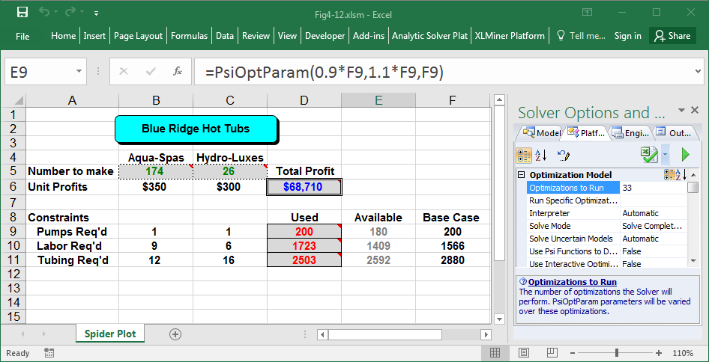
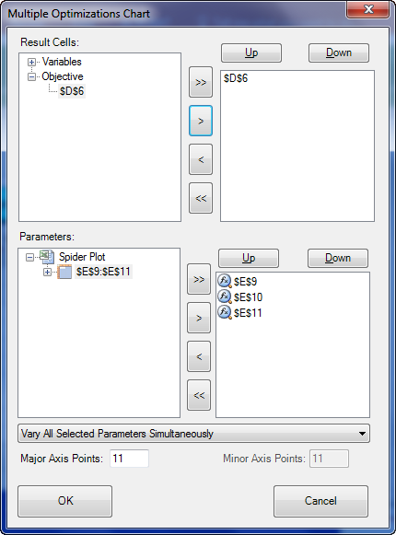
Spider Tables & Plots
See file: Fig4-12.xlsm

Slide 29
Solver Tables
Summarizes the optimal values of multiple output cells as changes are made to one input/parameter cell
Use PsiOptParam( min, max, base_case ) to specify values for the input cell to take on across multiple optimizations
See file: Fig4-16.xlsm

Slide 30
The Simplex Method
To use the simplex method, we first convert all inequalities to equalities by adding slack variables to <= constraints and subtracting slack variables from >= constraints.
For example: a_{k1}X₁ + a_{k2}X₂ + … + a_{kn}X_{n} <= b_{k}
converts to: a_{k1}X₁ + a_{k2}X₂ + … + a_{kn}X_{n} + S_{k} = b_{k}
And: a_{k1}X₁ + a_{k2}X₂ + … + a_{kn}X_{n} >= b_{k}
converts to: a_{k1}X₁ + a_{k2}X₂ + … + a_{kn}X_{n} - S_{k} = b_{k}

Slide 31
For Our Example Problem...
MAX: 350X₁ + 300X₂ } profit
S.T.: 1X₁ + 1X₂ + S₁ = 200 } pumps
9X₁ + 6X₂ + S₂ = 1566 } labor
12X₁ + 16X₂ + S₃ = 2880 } tubing
X₁, X₂, S₁, S₂, S₃ >= 0 } nonnegativity
If there are n variables in a system of m equations (where n>m) we can select any m variables and solve the equations (setting the remaining n-m variables to zero.)

Slide 32
Possible Basic Feasible Solutions
Basic Nonbasic Objective
Variables Variables Solution Value
1 S₁, S₂, S₃ X₁, X₂ X₁=0, X₂=0, S₁=200, S₂=1566, S₃=2880 0
2 X₁, S₁, S₃ X₂, S₂ X₁=174, X₂=0, S₁=26, S₂=0, S₃=792 60,900
3 X₁, X₂, S₃ S₁, S₂ X₁=122, X₂=78, S₁=0, S₂=0, S₃=168 66,100
4 X₁, X₂, S₂ S₁, S₃ X₁=80, X₂=120, S₁=0, S₂=126, S₃=0 64,000
5 X₂, S₁, S₂ X₁, S₃ X₁=0, X₂=180, S₁=20, S₂=486, S₃=0 54,000
6* X₁, X₂, S₁ S₂, S₃ X₁=108, X₂=99, S₁=-7, S₂=0, S₃=0 67,500
7* X₁, S₁, S₂ X₂, S₃ X₁=240, X₂=0, S₁=-40, S₂=-594, S₃=0 84,000
8* X₁, S₂, S₃ X₂, S₁ X₁=200, X2=0, S₁=0, S₂=-234, S₃=480 70,000
9* X₂, S₂, S₃ X₁, S₁ X₁=0, X₂=200, S₁=0, S₂=366, S₃=-320 60,000
10* X₂, S₁, S₃ X₁, S2 X₁=0, X₂=261, S₁=-61, S₂=0, S₃=-1296 78,300
* denotes infeasible solutions

Slide 33
Basic Feasible Solutions & Extreme Points
X₂
250
Basic Feasible Solutions
1 X₁=0, X₂=0, S₁=200, S₂=1566, S₃=2880
2 X₁=174, X₂=0, S₁=26, S₂=0, S₃=792
3 X₁=122, X₂=78, S₁=0, S₂=0, S₃=168
4 X₁=80, X₂=120, S₁=0, S₂=126, S₃=0
5 X₁=0, X₂=180, S₁=20, S₂=486, S₃=0
200
5
150
4
100
3
50
1
2
0
0
50
100
150
200
250
X₁

Slide 34
Simplex Method Summary
Identify any basic feasible solution (or extreme point) for an LP problem, then moving to an adjacent extreme point if such a move improves the value of the objective function.
Moving from one extreme point to an adjacent one occurs by switching one of the basic variables with one of the nonbasic variables to create a new basic feasible solution (for an adjacent extreme point).
When no adjacent extreme point has a better objective function value, stop -- the current extreme point is optimal.

Slide 35
End of Chapter 4

Slide 36

The Analytic Solver Platform software featured in this book is provided by Frontline Systems. http://www.solver.com

